Slide 1
Public Trust in the banking industry – how bad is it?
Ben Page, Chief Executive, Ipsos MORI
ben.page@ipsos.com
@benatipsosmori

Slide 2
Who do you trust to tell the truth?
“Now I will read you a list of different types of people. For each would you tell me if you generally trust them to tell the truth, or not?”
% trust to tell the truth
Base: 998 British adults aged 15+, fieldwork 20 - 26 October 2017

Slide 3
Trust in experts is rising
% trust to tell the truth:
Doctors
Teachers
Professors +15
Scientists +20
Police +13
Clergy -20ppts
Civil Servants +34
Business leaders +11
Journalists +8
Politicians
Base: c. 1,000 British adults aged 15+ per year
Source: Ipsos MORI/Unbound

Slide 4
Trust in business leaders and bankers
% trust to tell the truth:
Base: c. 1,000 British adults aged 15+ per year
*: This profession listed for the first time in 2017

Slide 5
Trust has different aspects
Interactive trust: Going beyond what the regulations require
Safety: consumer’ money and health is not at risk
Quality: the product or service works
Social activism: taking a stance on current socio-political issues.
Accessibility: any issues encountered can be resolved quickly and easily
Authenticity: the back office matches the front office
Notes:
Interactive trust: Going beyond what the regulations require to make the customer feel important and valued by the business.
Social activism: taking a stance on current socio-political issues.
Authenticity: the back office matches the front office
Safety: consumers want to be confident that their money in the former, or health in the latter, are not at risk.
Accessibility: When a customer encounters an issue, they want to feel like they can connect with the business to resolve it in a straightforward and timely manner
Quality: the product or service works

Slide 6
In their words
Safety: “ Whatever else they do you expect your money to be safe in the bank, even without the FSCS guarantee”
Interactive trust: “They actually help, it’s not just computer says no”
Quality: “Fundamentally, can they do what they say they will do”
Social activism: "I think these days people think more about what the business does to make money, it’s nice to use companies which aren’t wrecking the planet”
Accessibility: “Nobody’s perfect, the test is how well they fix things when things go wrong”
Authenticity: “One of the big things for people with the 2008 crash was the banks weren’t transparent, they were saying one thing, but doing something completely different ”
Notes:
Here are some articulations from the recent research

Slide 7
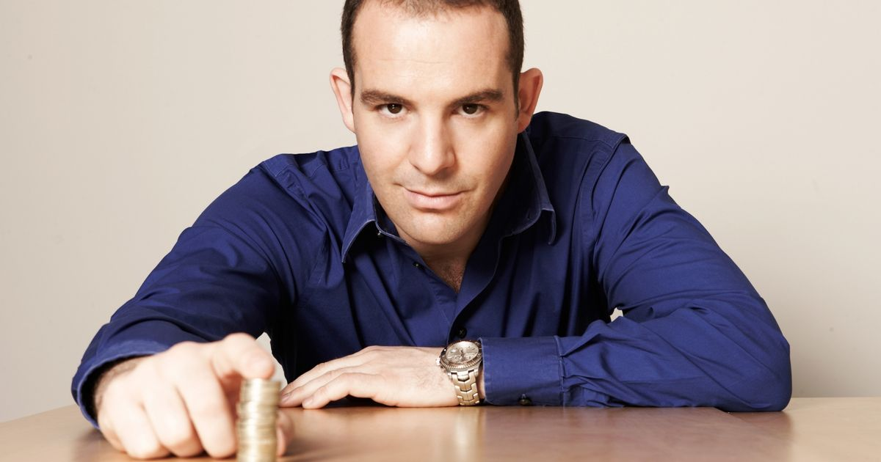
Martin Lewis : the trust equation made flesh
Credibility: seen as knowledgeable, passionate and offering sound advice
Reliability: has been offering advice for many years
Intimacy: is thought of as ’a person’, not a business / institution
Not self-interested: Not perceived to have an ulterior motive or agenda
“I would trust Martin Lewis, I’ve never heard anyone say a bad word about him and his motivation is to help everyday people”
Notes:
Not strictly universal – i.e. may have lost some of his lustre from previously (but aligns well with Maister’s trust equation).
Not just this work but other’s Russian Fintech anecdote.

Slide 8
Trust in The Banking Industry

Slide 9
Trust in banking is mixed
Forced to use (not choose)
Lacks transparency
Consumers trust banks with their money but not to behave ethically
Employees seen to act in the bank’s best interest, not the customers
They have targets to meet which makes you think ‘these guys aren’t working for me, they are working for the incentive they get at the end of the month if they sell this many products’.”
Notes:
A forced choice: you need a bank to live, there’s not an option not to use – forced to trust banks to a degree
Lack of transparency: there is a lack of transparency about what’s going on in banking – this might have been fine, if it weren’t for issues like the 2008 crash which felt to the everyday person to come out of no-where, and they were forced to pay attention, as it had ramifications for their every day lives. Damaged credbility
Trust the banks not to lose their money – so seen as generally reliable, but don’t trust them to necessarily act ethically therefore seen as self interested or self oriented.

Slide 10
Digital and human interactions support different elements of trust
Reliability
Intimacy
Rational /predictable
Inflexible
Incapable of understanding complexity
Able to empathise
Ability to be flexible
Fallible / less predictable
A friend of mine works with computers and he says they will work, they only don’t if a human’s done something wrong”
I know they work but you just can’t explain yourself to a machine, if they aren’t programmed to answer your question you go round and round”
Notes:
Consumers don’t think about the people behind the digital
Therefore, though a machine is trusted to do what it is meant to do predictably, a person, despite their unpredictability, is trusted more due to their potential to empathise

Slide 11
Banking has challenges to each of the elements tied to trust
Trustworthiness =
Credibility + Reliability + Intimacy
Self interest
Source: The Trusted Advisor, by David Maister
Notes:
Credibility- 2008 still referenced – but improving
Despite some hiccups – generally seen as reliable
Intimacy poor and getting worse
Seen as strongly self interested
Can shift credibility, deal with reliability (difficulty with intimacy and self interest)

Slide 12
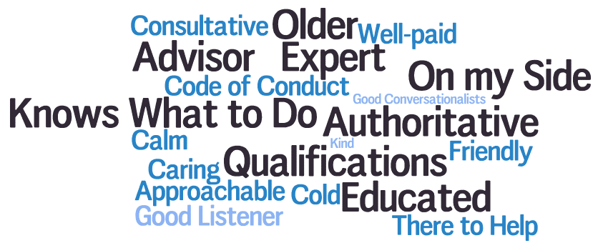
Professions: associated with education, expertise and competence
Notes:
Were going to talk generally about professionalism and then explore the implications for banking. Here are some of the immediate associations with professionalism amongst UK consumers. Note we started with professional, the explored professional standards and professional bodies one by one.
It’s fair to say people have instinctive associations with what a professional is, the way they hold themselves, the type of things they expect from them, but far more limited in terms of professional qualifications and professional bodies what they do and the consumer benefit
Professionalism has a clear link with trust equation: credibility (examples) , reliability (examples), intimacy (examples), and not self interested (i.e. on consumers side)

Slide 13
But low awareness of professional bodies
Some awareness of professions (medicine, law) but poor understanding of what they do
Assumed that have role in training and developing members of the industry
Perceived value if they have the power to hold members accountable for their actions
They add a second layer of liability because they are also responsible if something goes wrong”
I imagine (the BMA) they are there to look after the interests of their members, but I’ve no real sense of what they do”
Notes:
Very limited awaress of professional bodies – few could name any (again unless they were themselves members). Again, it was again about additional liability, authority, and control over members to ensure they know what the rules are and follow these rules

Slide 14
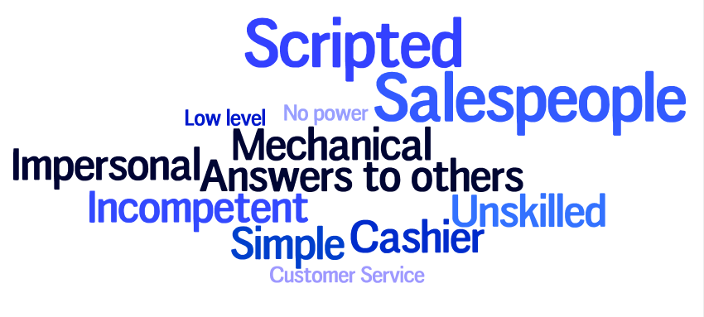
People who work in banks?
Notes:
Banks – the immediate associations with those working in banks was not professional

Slide 15
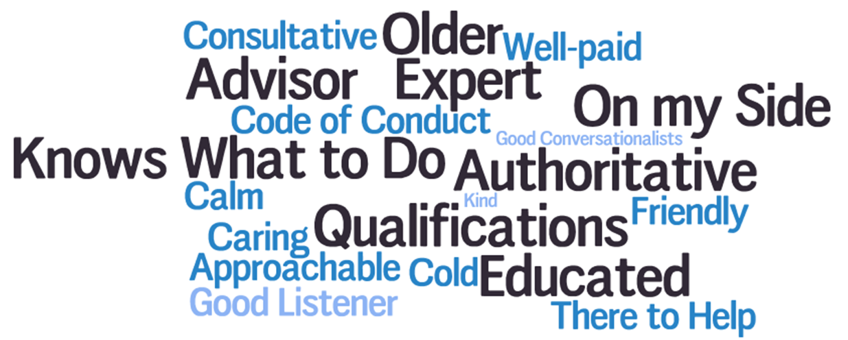
Fixing the trust equation
Trustworthiness =
Credibility + Reliability + Intimacy
Self interest
Source: The Trusted Advisor, by David Maister
Notes:
Clearly some challenges around professionalism in banking - but also a potential opportunity.
Develop ideas / interventions which support some of the positive associations with professionalism which are linked with other industries
We feel that intimacy (given digital trends ) is challenging and self interest (given this is very firmly embedded in consumers perceptions of the industry) will be very difficult to shift
More opportunity to use professionalism to support credibility and reliability – this is what we’re here to do

Slide 16
Conclusions
First – no collapse in trust: better than many professions
But challenge of low awareness…and
Challenge self interest perception – jobs, credit, trade
How much can the industry do itself?
How much should the Chartered Banker Institute do?
Demonstrate “teeth” – but not too much
Build on strong reliability and consistency – with digital intimacy?
Over to you!

Slide 17
THANK YOU
Ben Page, Chief Executive, Ipsos MORI
ben.page@ipsos.com
@benatipsosmori

